Slide 1

BUSINESS DATA MANAGEMENT
Helping Offline Stores through E-Commerce
Varun Ram S 21F1001490@ds.study.iitm.ac.in

Slide 2

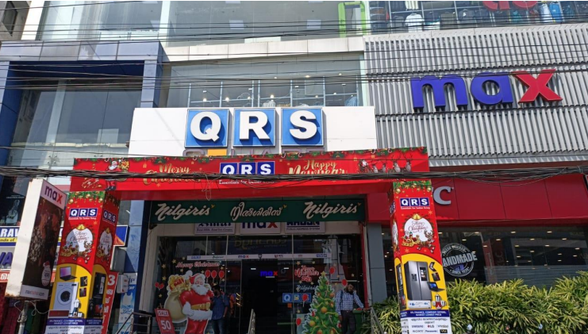
Overview of the Business Organization
B2C Organization
Primary sales are consumer electronics
Multiple branches across South Kerala
Established in 1947 dealing only with Philips Radios and Radiograms
Organization website: https://www.qrs.in/pages/index

Slide 3



Problem Statement Overview
Dealing with excess inventory at the store
Keeping up with competition from E-commerce and other stores.
Tackling the issue of dwindling reach in stores locality

Slide 4
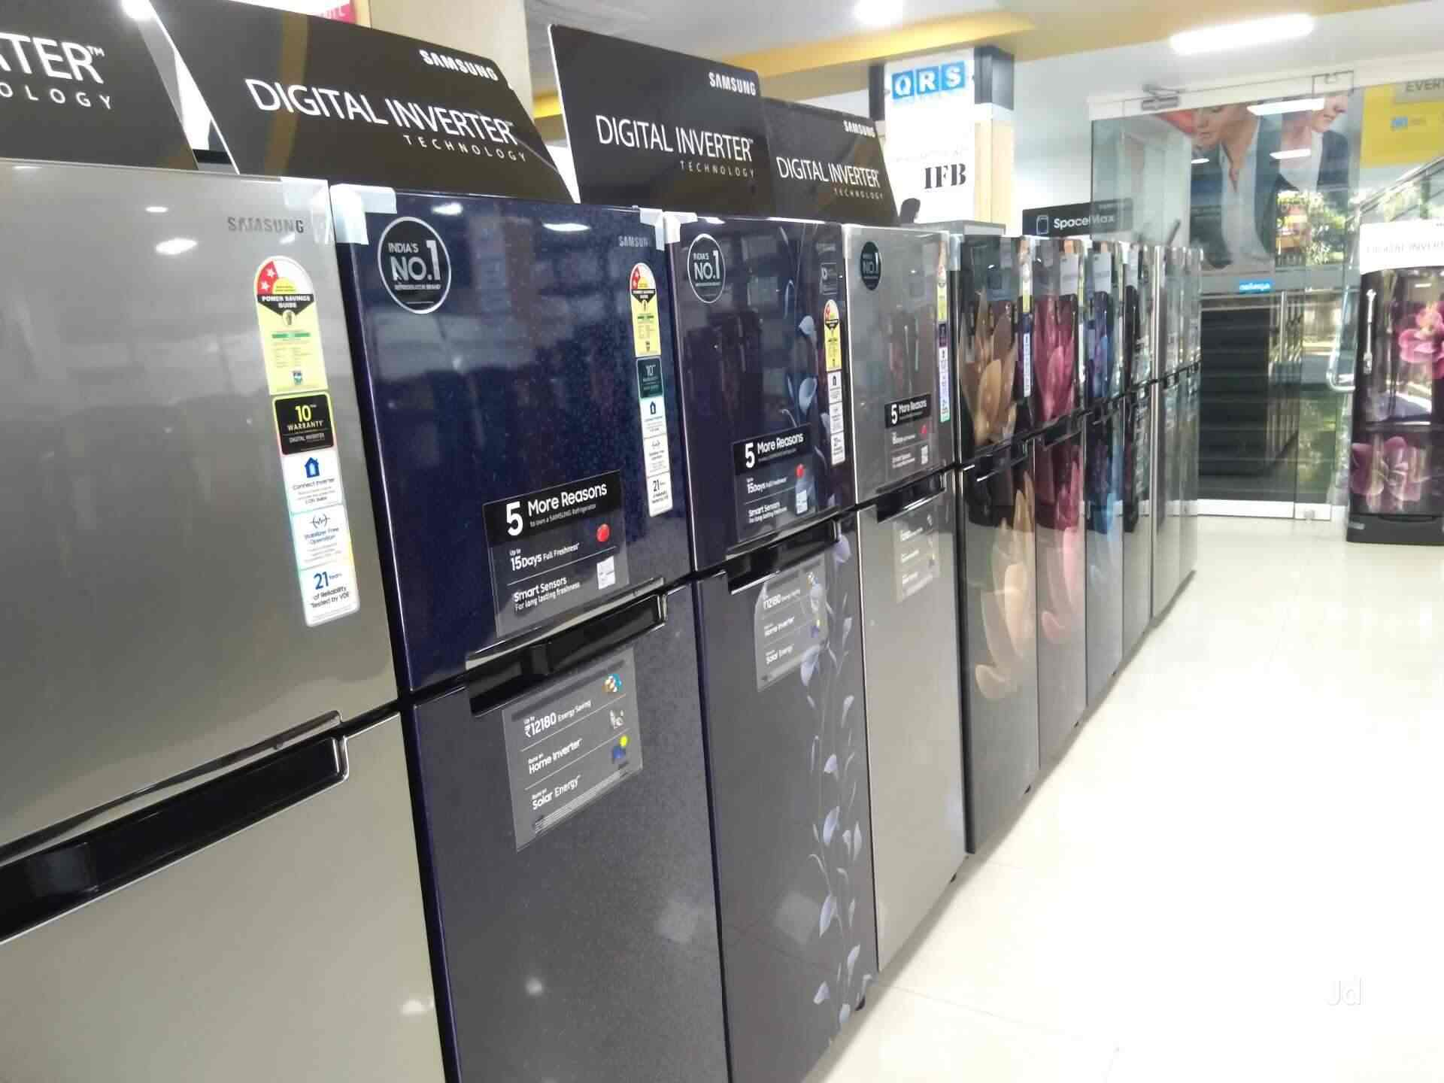
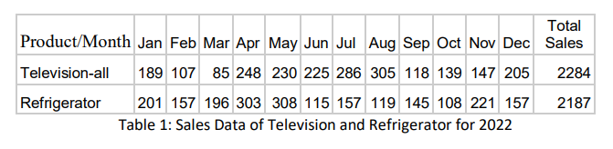
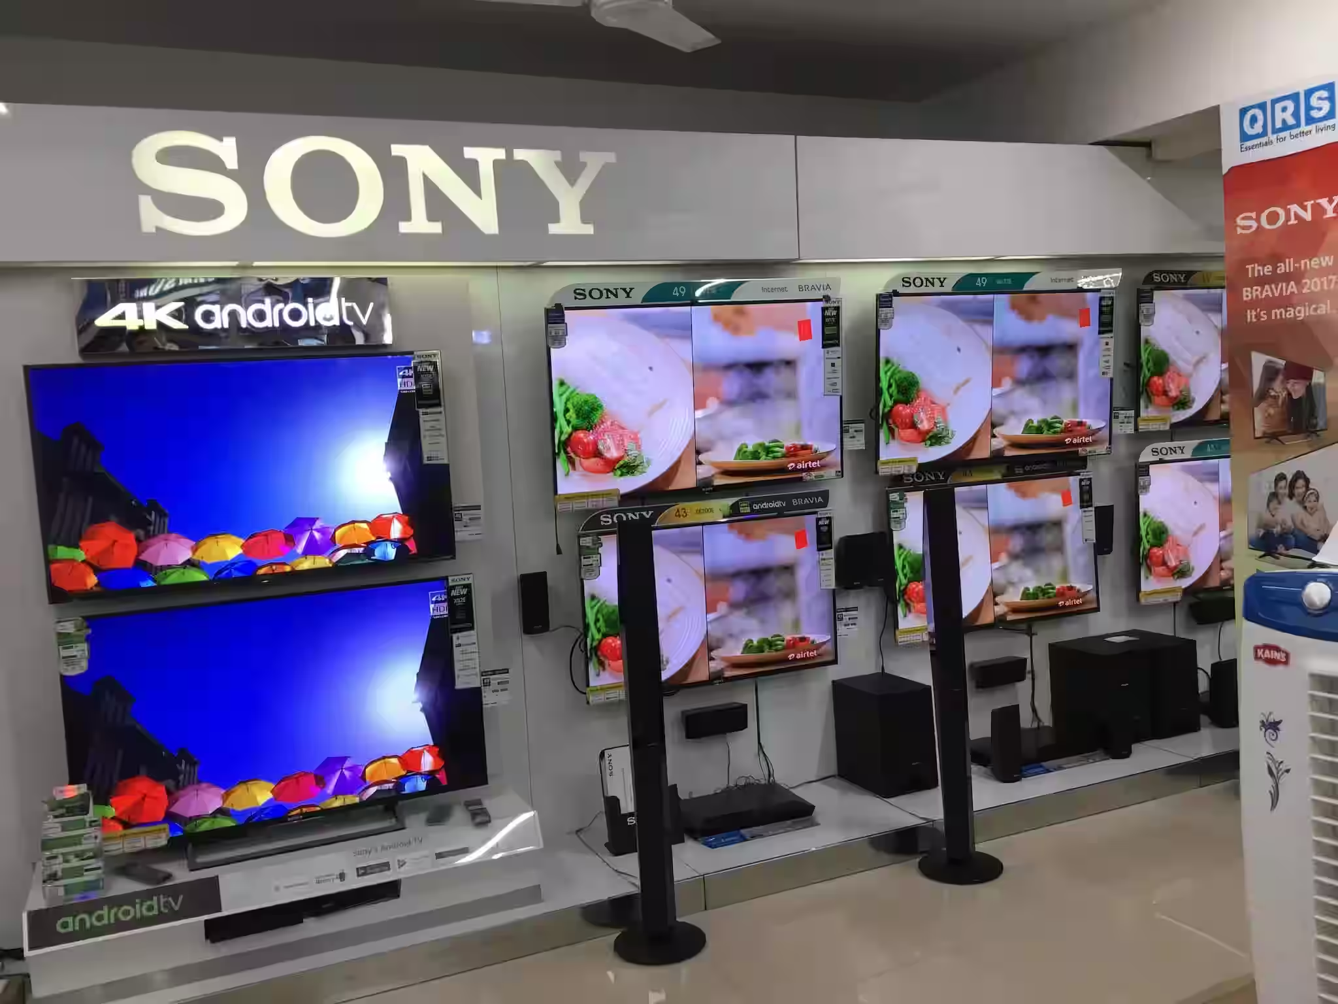
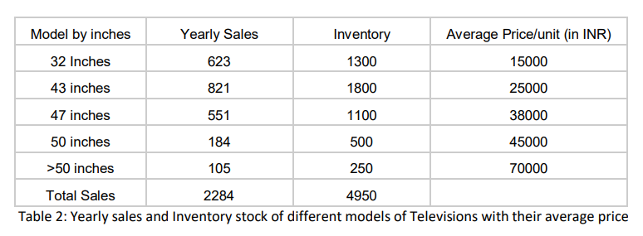
Data Collected from the Organization
.

Slide 5

Methodology for Problem Solving
Identify the months with most and least sales (Excel for analysis)
Find the months where there is significant downfall and plan ideas on what can be done
Using a Decision Tree classifier to find correlation between months and sales.
Identify trends during festival seasons.
Suggest a ratio between the amount of goods to be sold between the independent ecommerce platform and the offline retail stores.

Slide 6

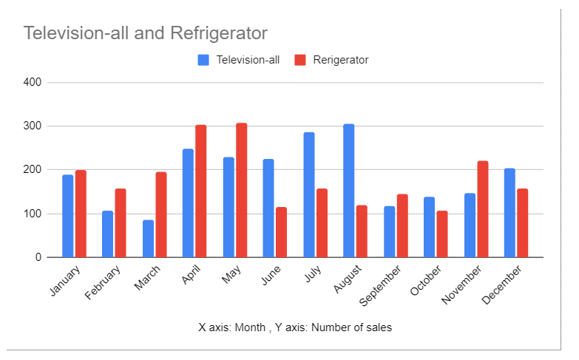
Results and Findings - 1
Inventory of April, May and August don’t require changes
Advertising and Discounts to be accelerated during January and December (festival season)
A good portion of the inventory should be allotted to the online websites for the months of February, March, October and November
Television: Mean = 190 units, S.D = 70 units
Refrigerator: Mean = 182 units, S.D = 68 units

Slide 7
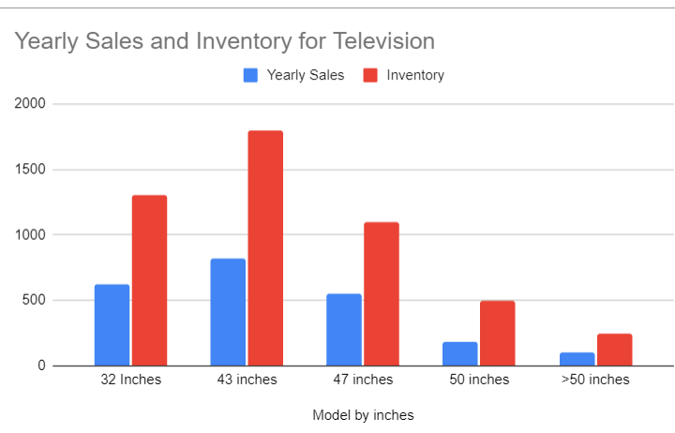
Results and Findings - 2
43 inches model is the best-selling model
The price of models of 50 inches and above should be kept at least 10% lower for better sales.
The price of 32 inch model can be raised by about 5% for a better business outcome.
The models greater than 50 inches should also be given extended warranty.
Around 25% of the inventory can be put up on the online website for sales

Slide 8
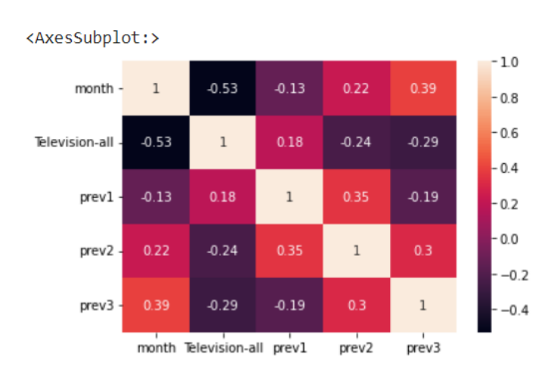
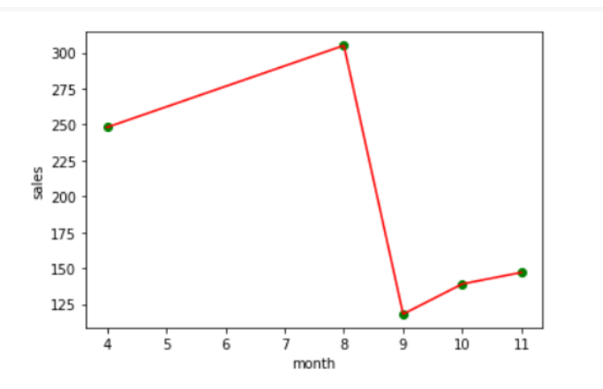
Results and Findings - 3
Identification of the pattern for 3 months using the heat map as generated
There is significant downfall from the 8th to the 9th month (i.e., from August to September). This clearly Indicated that the online presence and optimizing inventory is important for the Month of September
The store can introduce a random scheme called “End of the year scheme” for better sales from November to January

Slide 9
SWOT Analysis of the Store (as of April 2023)
STRENGTHS
Good presence and locations in Kerala
Legacy of over 75 years
Customer trust
WEAKNESSES
Relatively inactive Online website
Lack of Inventory Management System
S
W
Expansion into other states of India
Going beyond consumer electronics
OPPORTUNITIES
Competition from other retail stores
Competition from other E-commerce giants
THREATS
O
T

Slide 10
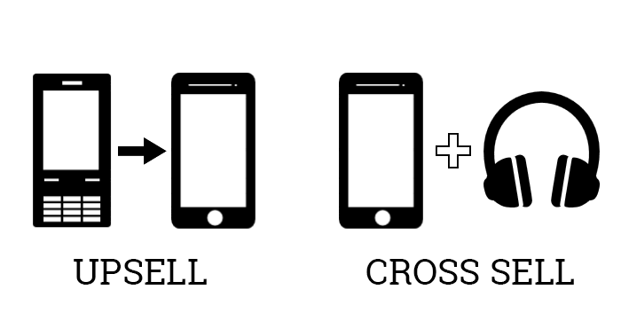

General Recommendations
Implement Inventory Management Software
Use cross selling and up selling techniques
Promote their online website
Offer Special Deals and Discounts (based on frequent analysis). This should be different for online and offline mode.
Partner with other similar stores at occasions

Slide 11
THANK YOU!!!

